Slide 1









NOTICE: Proprietary and Confidential This material is proprietary to Geocent. It contains trade secrets and confidential information which is solely the property of Geocent. This material is solely for the Client’s internal use. This material shall not be used, reproduced, copied, disclosed, transmitted, in whole or in part, without the express consent of Geocent. © 2009 All rights reserved
Centered on Solutions
Sprint Artifact
GSA 18F BPA Agile RFQ
Sprint 1 Review
June 22, 2015

Slide 2
Agenda
Goals/Definition of Done/Name of Product
Artifacts: Status
Organizational Chart
Technologies Chart
Architectural Diagrams
Branching Strategy
UI Mock-up
Sprint 1 Demonstration
Sprint 1 Stories
Sprint 1 Burndown Chart
Sprint Schedule
Sprint 1 Retrospective

Slide 3
Sprint 1: Architecture, Development, and Test
Goals:
Finalize Architecture
Begin Development
Establish Testing Plan and implement
First Version of Prototype: Basic capabilities to initiate the search (query to pull data) and display of results (graphics, lists, 3D models)
Focus on Product and Process
Definition of Done: Sprint 1
Development Stories
Tested in Integration branch/CI
Unit Test validation (Jenkins),
End-to-End validation (Jenkins)
Name of Product:
Drug Interaction Query (Drug IQ)

Slide 4
Sprint 1: Artifacts
Artifacts | Status
Set up CI and CM | Done
CI Design doc | In progress
CM doc | In progress
PMP and QA | Updated as project evolves
Org chart for project | Slide 5, documented in PMP
Technologies | Slide 6, documented in PMP
Architecture Diagram | Slides 7-8
Branching Structure | Slides 9-10, documented in PMP
UI Mock-up | Slides 11-16
Playbook – record details of work in google docs and extract text from Skype to document project progress | Need to capture message traffic and automated tests/builds
Defects/Issue Management Process documents | In progress
Domains needed with SSL searches | Done

Slide 5
Sprint 1: Organizational Chart
Product Manager
Keith Alphonso
Agile Coach
Roberta Hazelbaker
Interaction Designer
Vance Lowe
Frontend Web Developers
DevOps Eng
Tyler Sanders
Technical Architect
Jared Ladner
Visual Designer
Josh Penton
Delivery Managert
Brian Priest
Aaron Whitney
Randy Nolan

Slide 6
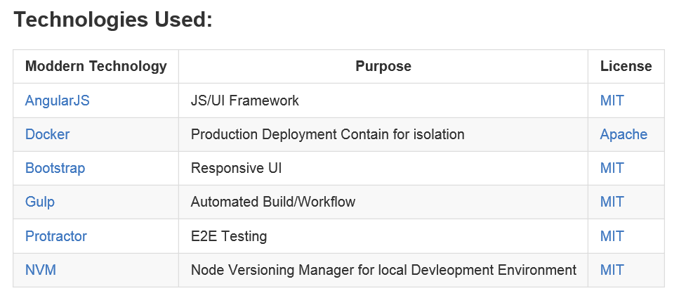
Sprint 1: Technologies Chart
Discussion: Technologies Chart needs to be updated, add D3/NVD3. (Tyler)

Slide 7
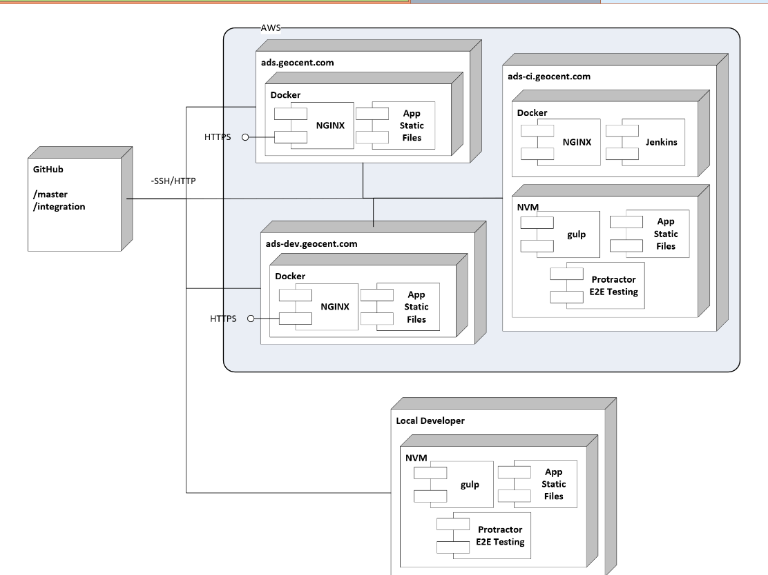
Sprint 1: Architectural Diagram

Slide 8
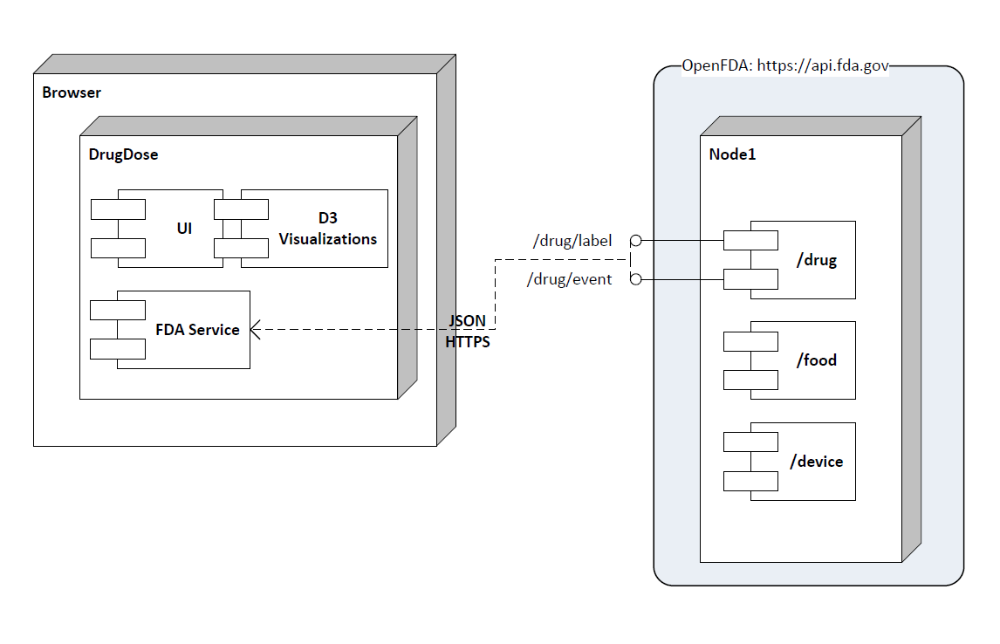
Sprint 1: Architectural Diagram
Continued
Discussion: Drug Dose needs to be changed to Drug IQ. (Jared)

Slide 9
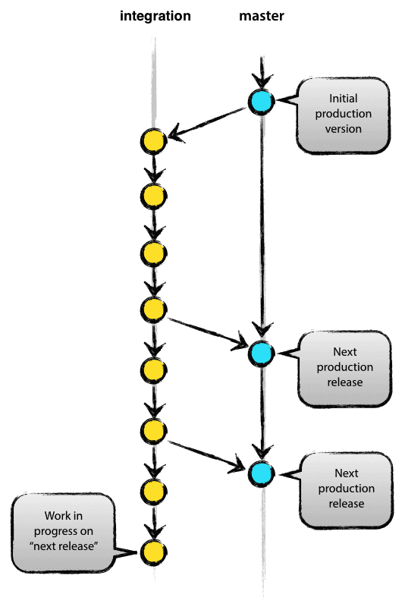
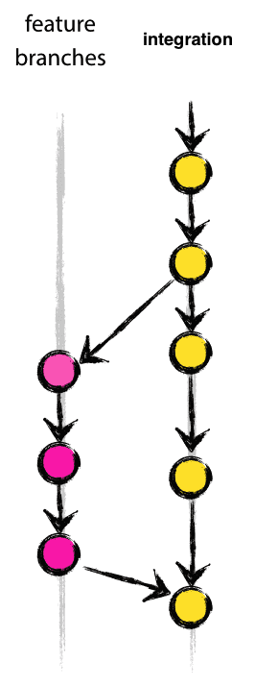
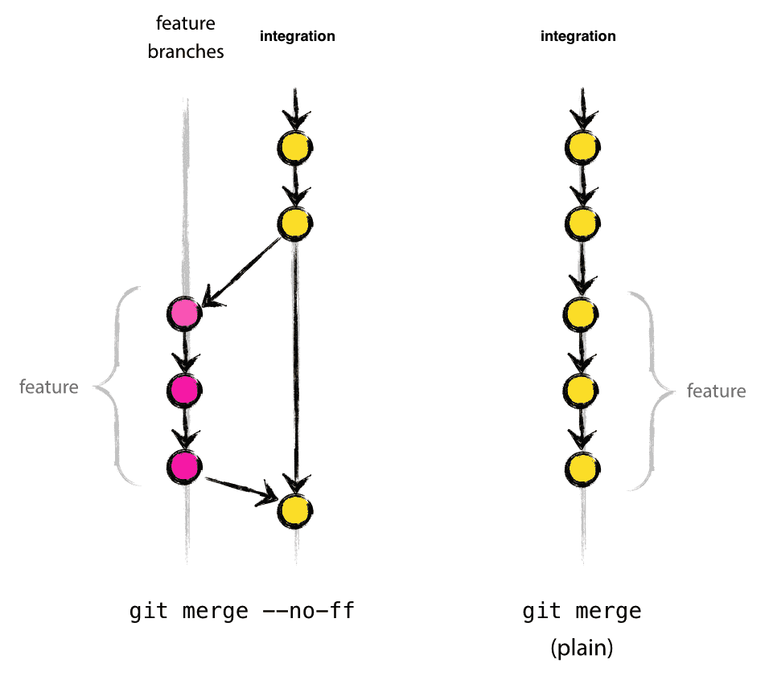
Sprint 1: Branching Strategy
Main Branching
Feature Branching
Finished Feature Integration

Slide 10
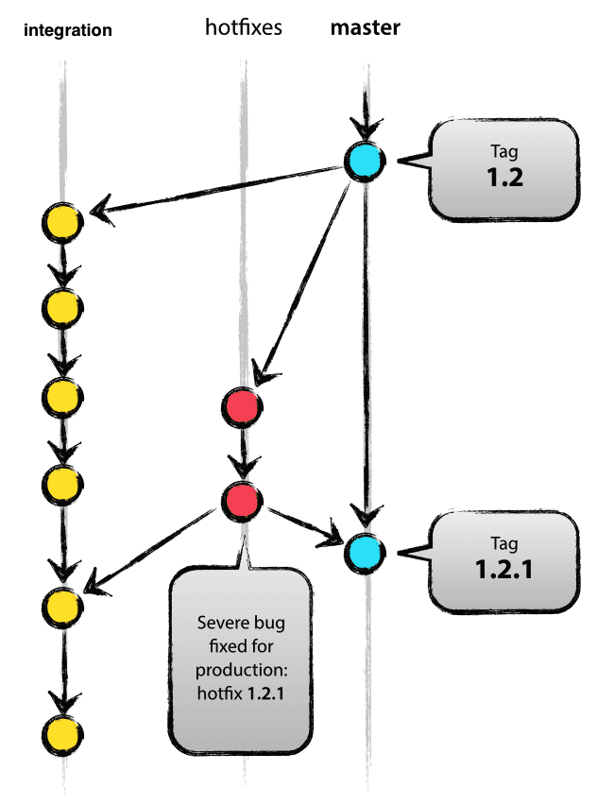
Sprint 1: Branching Strategy
Continued
Hotfix Branching

Slide 11
Sprint 1: UI Mock up
Discussion: UI tested with user community, determine more user instructions are needed.
Story will be added for Sprint 2.

Slide 12
Sprint 1: UI Mock up
Continued

Slide 13
Sprint 1: UI Mock up
Continued

Slide 14
Sprint 1: UI Mock up
Continued

Slide 15
Sprint 1: UI Mock up
Continued

Slide 16
Sprint 1: UI Mock up
Continued

Slide 17
Sprint 1: Demonstration

Slide 18
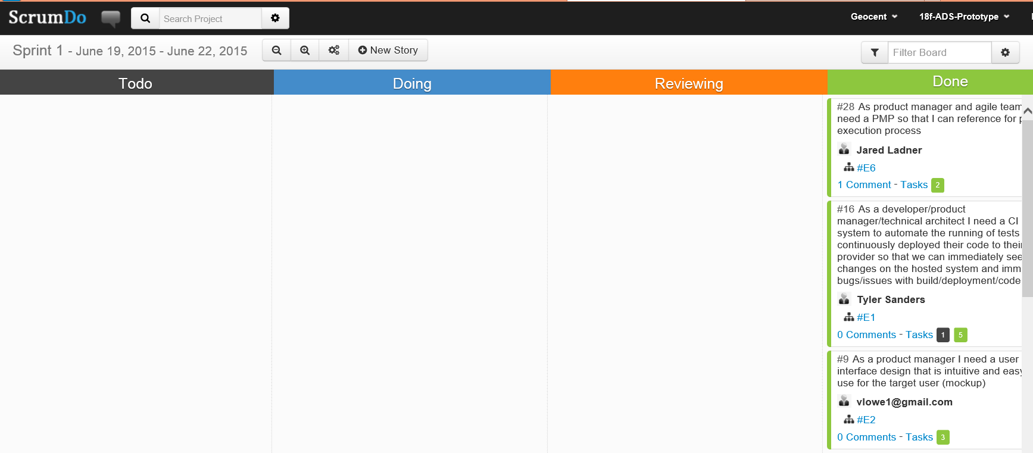
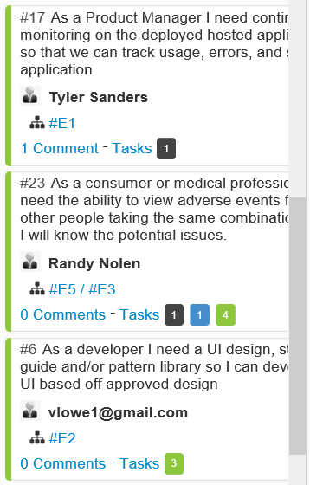
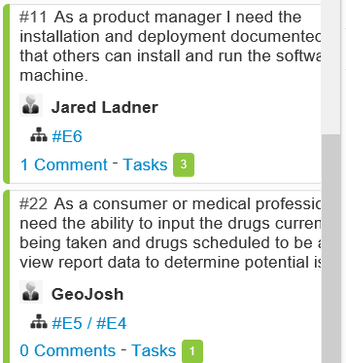
Sprint 1: Stories
Stories Completed:
#6
#9
#11
#16
#17
#22
#23
#28

Slide 19
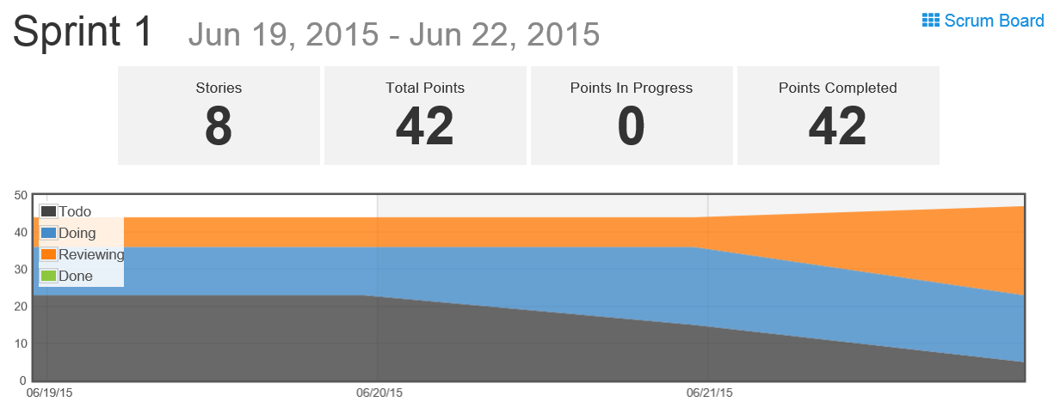
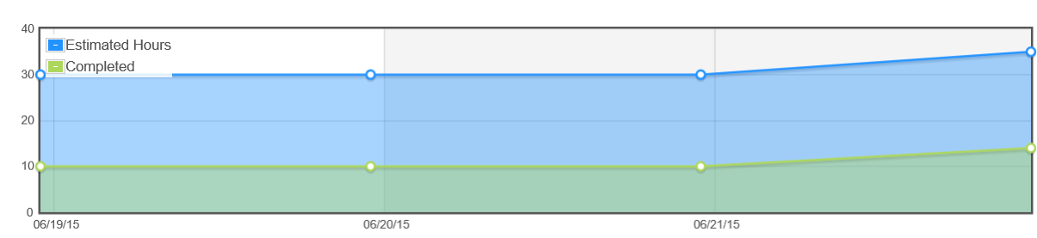
Sprint 1: Burndown Chart

Slide 20
Sprint Schedule
Sprint 0 – Capture Sprint
6/17/2015
Sprint 0 Planning: 6/17
Sprint 0 Review: 6/18
Sprint 1 – Architecture, Development, Testing
6/18/2015 – 6/22/2015
Sprint 1 Planning: 6/18
Sprint 1 Review: 6/23
Sprint 2 – Finalize Product, Final QA Testing, User Testing
6/23/2015 – 6/24/2015
Sprint 2 Planning: 6/23
Sprint 2 Review: 6/25
Sprint 3 – Stabilization Sprint
6/25/2015
Deliver
6/26/2015
Completed
Completed

Slide 21
Sprint 1: Retrospective
What went well?
We have a working prototype in 2 days!!
Skype chat was very helpful to communicate across multiple geographic locations/offices within Geocent.
Complete automated development environment setup which allowed developers to start coding within 1 hours of coming onto the project
Automated deployment to AWS for developer integration
Developers brought individual expertise in various technologies and helped the team learn them quickly
Team handled 2 day sprints very well.
What did not go well?
Short timeline of project caused initial mockups to be created in parallel with development of prototype; this caused some rework.
Challenges with other project responsibilities; all teammates support this prototype and their on going projects
Was not clear on branching strategy early on causing some features not to be pushed to CI
What would you change?
More time on project. 2 full weeks of development would have been nice.

Slide 22

Questions

Slide 23


